Slide 1
Modbus Communication
Automation of new EBC test hall
Matthias Mersch

Slide 2
Overview
Control of Belimo VAV/VVS valves
Modbus RTU protocol via RS485 interface
Implementation in Beckhoff TwinCAT 3 (structured text)
EL6021 terminal
Modbus RTU
VAV/VVS 1
PLC
TwinCAT 3
EL
6021
EtherCAT
VAV/VVS n

Slide 3
Modbus Remote Terminal Unit (RTU) protocol
Serial communication ➔ bit by bit
Master/Slave protocol
One master, up to 32 slaves with unique address (1..247)
Only master can initiate communication, slaves can only respond to requests
Broadcast mode or communication with single slave
Slaves can store data in four different tables
Standard function codes to access tables
Data package
Table | Data Type | Access
Output Coils | Single bit | Read/Write
Input Coils | Single bit | Read-only
Input Registers | 16-bit unsigned | Read-only
Holding Registers | 16-bit unsigned | Read/Write
Device Address | Function Code | Data | Cyclic Redundancy Check
1 Byte | 1 Byte | n Bytes | 2 Bytes

Slide 4
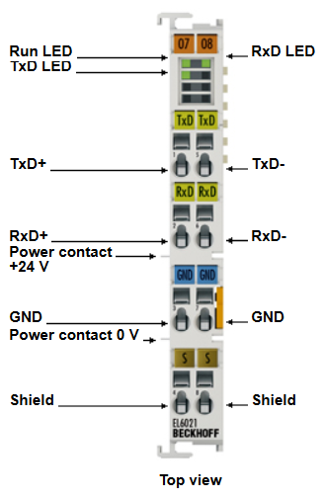
Hardware Components
Beckhoff EL6021 | Serial interface RS422/RS485
Connection to PLC via E-bus coupler EK1100
TxD and RxD communication channels, full/half duplex mode possible
2400..115200 baud
Number of data bits, parity, and stop bits variable
Up to 1000m twisted pair cable
A maximum of 32 devices connected to terminal as daisy-chain
Termination resistors
2 x 120Ω
Between the two wires of the pair at both ends
Ground
Shield

Slide 5
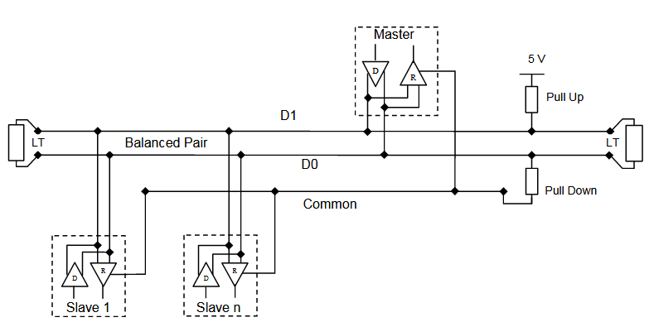
Electrical Wiring
Two-Wire EIA/TIS-485 (RS485)
TxD+ and RxD+ pins are bridged to form D+ signal (not inverted)
TxD- and RxD- pins are bridged to form D- signal (inverted)
Common ground
Termination resistors
Source: http://www.modbus.org/docs/Modbus_over_serial_line_V1.pdf

Slide 6
Software Requirements
Beckhoff TwinCAT 3 PLC (with Microsoft Visual Studio)
Tc2_ModbusRTU library

Slide 7
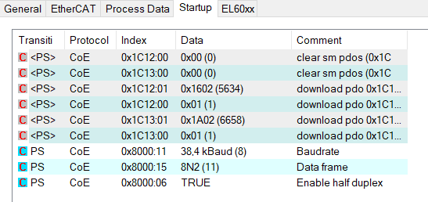
CoE settings for EL6021 terminal
Set Baudrate (0x8000:11) to match slave (here 38.4 kBaud)
Set Data frame (0x800:15) to match slave (here 8N2)
8 Data bits
No parity
2 stopbits
Enable half duplex (0x8000:06) (required for RS485 communication) ➔ Add settings to startup list

Slide 8
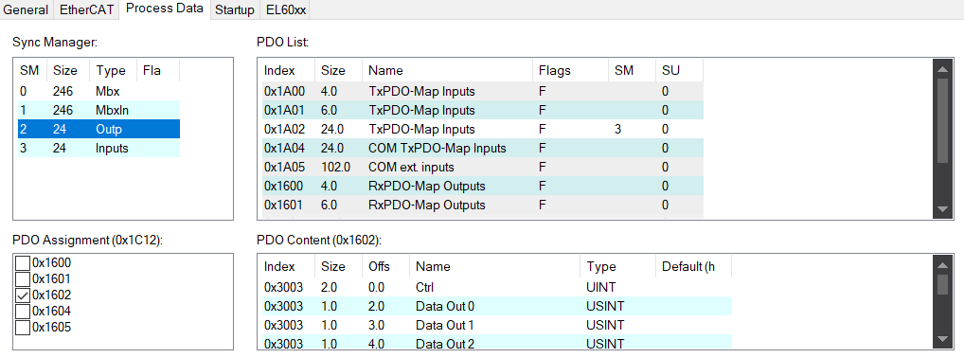
Process Data (PDO assignment)
Use 22x8 bit input, 22x8 bit output
Inputs PDO Assignment 0x1A02 (Status + Data In [0..21])
Outp PDO Assignment 0x1602 (Ctrl + Data Out [0..21])
Other options are 3x8 bit, 5x8 bit and 22x8 bit virtual COM

Slide 9
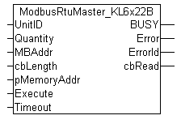
Modbus RTU Library
Use function blocks from ModbusRTU library
Here: ModbusRtuMaster_KL6x22B
Modbus Master
KL6xxx terminal
22B process data interface
Blocks for Modbus slaves and other process data interfaces available
Function blocks implement low-level serial communication according to Modbus RTU protocol
Input- and Output-Buffers are included
Function block actions implement the basic Modbus functions
Reading and writing of coils/registers
Documentation: https://infosys.beckhoff.com/index.php?content=../content/1031/tcplclibmodbusrtu/9007199710009867.html&id=7075213495716034918

Slide 10

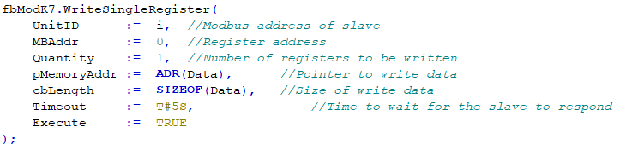
Software Implementation (1/3)
Create instance of function block
Call Instance.<<Action>>
Here, a register of the slave device is written
UnitID is the modbus address of the slave [0..247, BYTE]
MBAddr is the address of the register on the slave [0..9998, 0x0000..0x270E, WORD]
Quantity is the number of registers to be written
Data is an array of WORD, its size has to be according to Quantity
Timeout should not be less than 5s to allow time for the slave to respond
A rising edge of the Execute input (False -> True) starts the operation

Slide 11

Software Implementation (2/3)
Wait for the process to finish
Master has to finish one action before the next one can be started
Call Instance.<<Action>> until master is not busy any more
Execute needs to be false, because the action is already being performed
Potential errors are monitored
➔ Other modbus functions can be implemented by using different actions

Slide 12
Software Implementation (3/3)
State machine to control operation sequence and avoid errors/delays
Example:
1. Step: Start writing setpoint
2. Step: Finish writing process
3. Step: Start reading current value
4. Step: Finish reading current value
The PLC runs independent of the speed of the modbus communication
The master performs actions sequentially, no errors due to parallel requests

Slide 13
IO links
Modbus master provides input and output structures
InData
Status (WORD)
D (Array [0..21] of BYTE)
OutData
Ctrl (WORD)
D (Array [0..21] of BYTE)
Variables are mapped to the inputs and outputs of the terminal
Activate array mode to map D to Data [0..21]
➔ Activate Configuration after mapping is changed, components may not work properly after a simple download or online change

Slide 14
Matthias Mersch
matthias.mersch@eonerc.rwth-aachen.de
matthias.mersch@rwth-aachen.de

